Slide 1



Lesson 11: React (Part 2)
<Web />
Front-end
Development
University of Tehran
Lecturer:
Misagh Mohaghegh
ACM
Summer of Code 2024

Slide 2
A Short Review…
Modules (export, import, default)
Bundling (and minification, uglification, transpilation)
Imperative vs Declarative
Virtual DOM
JSX
Function and class components
Props
Rendering lists and repeats
Conditionals
Different HTML attributes
Installation (CRA) and project structure

Slide 3
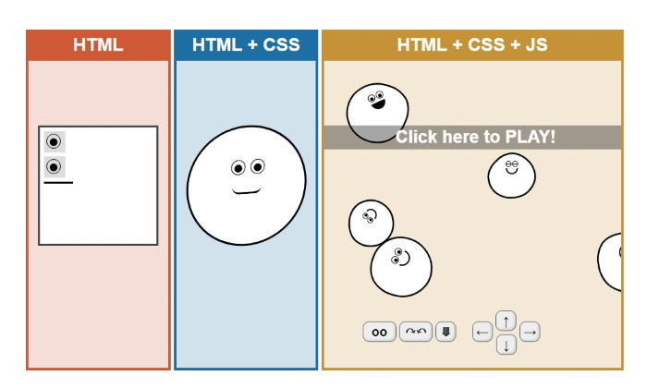

Continue…

Slide 4
React

Slide 5
State

Slide 6
State
State is used for a component to remember some information.
In React, we don't write commands such as "disable the button" or "show the message".
Instead, we describe our UI for different states such as "initial state" and "success state".

Slide 7
Hooks
React functions starting with "use" are called Hooks.
For example, useState is a Hook.
Hooks should only appear on the top-level of a component.

Slide 8
useState
The syntax for useState is as follows:
import { useState } from 'react';
function MyComponent() {
const [myVar, setMyVar] = useState(0);
return <p>{myVar}</p>;
}
useState takes the initial value (0 here, but it could be anything, even an object) and returns 2 values.
We should never directly set myVar and should instead use the setMyVar function.

Slide 9
Example
Lets say we want to have a button that counts how many times it has been clicked:
function MyButton() {
const [count, setCount] = useState(0);
function handleClick() {
setCount(count + 1);
}
return <button onClick={handleClick}>{count}</button>;
}

Slide 10
Lifting State Up
What if we want 2 buttons that share the same counter?
We should move the state to their parent and pass the values as props.
function MyButton({ count, onClick }) {
return <button onClick={onClick}>{count}</button>;
}
function ParentComponent() {
const [count, setCount] = useState(0);
function handleClick() {
setCount(count + 1);
}
return (<>
<MyButton count={count} onClick={setCount} />;
<MyButton count={count} onClick={setCount} />;
</>)
}

Slide 11
Updating Objects
What if our state is an object and we want to update only one field?
function Component() {
const [test, setTest] = useState({
first: '',
second: 0,
third: false
});
function handleChange(newFirst) {
setTest({ ...test, first: newFirst });
}
return ...
}

Slide 12
Updating Arrays
What if our state is an array and we want to update only one element?
function Component() {
const [test, setTest] = useState([
{ id: 0, name: 'first' },
{ id: 1, name: 'second' }
]);
function handleChange(id, newName) {
setTest(test.map(t => {
if (t.id === id) return { ...t, name: newName };
else return t;
});
}
}

Slide 13
Renders
The useState's set function does not change the value until the next re-render is triggered:
function MyButton() {
const [count, setCount] = useState(0);
function handleClick() {
setCount(count + 1);
console.log(count); // still the previous value
}
return <button onClick={handleClick}>{count}</button>;
}

Slide 14
Context

Slide 15
Prop Drilling
Prop drilling is the process of passing props down to children to reach a certain child on the bottom.
For example, we want to pass the current user's name to a form element that is 6 components deep from where the username is stored.
We have to pass the username as props to all components in their way so they can pass it downwards in the component tree.
Sometimes the components in the middle of the way do not even need the prop and just directly pass it to the children.
This can make our code complex.

Slide 16
Context
useContext is another Hook which allows us to pass implicit props to all children of an element in any depth without actually passing the prop.
This means that all child components and their children (the whole component subtree) can access a value without actually having it passed as a prop argument.
To access a value in such way, a context should be created first:
// ThemeContext.js
import { createContext } from 'react';
export const ThemeContext = createContext('light');

Slide 17
Provider
Now whichever part of the code that all children of it should access a value will be wrapped in the provider:
import { ThemeContext } from './ThemeContext';
function App() {
const [theme, setTheme] = useState('light');
return (
<ThemeContext.Provider value={theme}>
<SomeComponent />
</ThemeContext.Provider>
);
}

Slide 18
useContext
Now all children of <App /> can access the value of the nearest provider:
import { useContext } from 'react';
import { ThemeContext } from './ThemeContext';
function SomeComponent() {
const theme = useContext(ThemeContext);
...
}

Slide 19
Default Value
The value passed to the provider is accessed by useContext.
If no provider is found in the upper tree of where useContext was used, the default context value (which was passed to createContext) will be returned.
The context provider value will usually be a state variable which can trigger a re-render on the children that access it after a setState.

Slide 20
Effect

Slide 21
useEffect
The useEffect Hook is used mostly for fetching data from external systems.
We can also use it to run a code the first time a component is mounted, or on every update.
import { useEffect } from 'react';
function MyComponent() {
useEffect(() => {
...
}), []);
return ...;
}

Slide 22
useEffect
useEffect takes two parameters: a function and a dependency list.
Whenever a variable in the dependency list changes, the function is run.
If the list is empty, the function is only run once on component mount.
If we omit the list, the function will be run on every component update.
The function may return another function which will be run on component unmount.

Slide 23
React Router

Slide 24
React Router
React does not have any routing built-in.
React Router is a library that provides routing for our pages.
RouterProvider
createBrowserRouter
errorElement
useParams
useSearchParams
useNavigate
<Link />
npm install react-router-dom

Slide 25
Thank you for your attention.

